Slide 1

E-COMMERCE PURCHASE CASE STUDY MAMA EARTH
Manasi Gaikwad

Slide 2
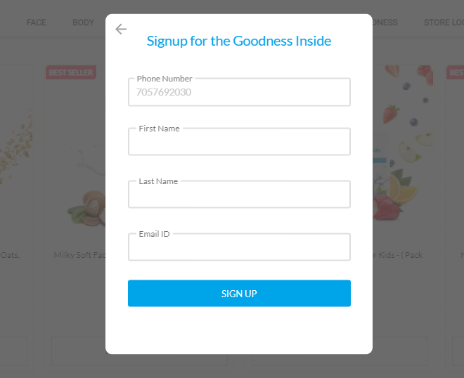
Sign up. Saves the user info in their database

Slide 3
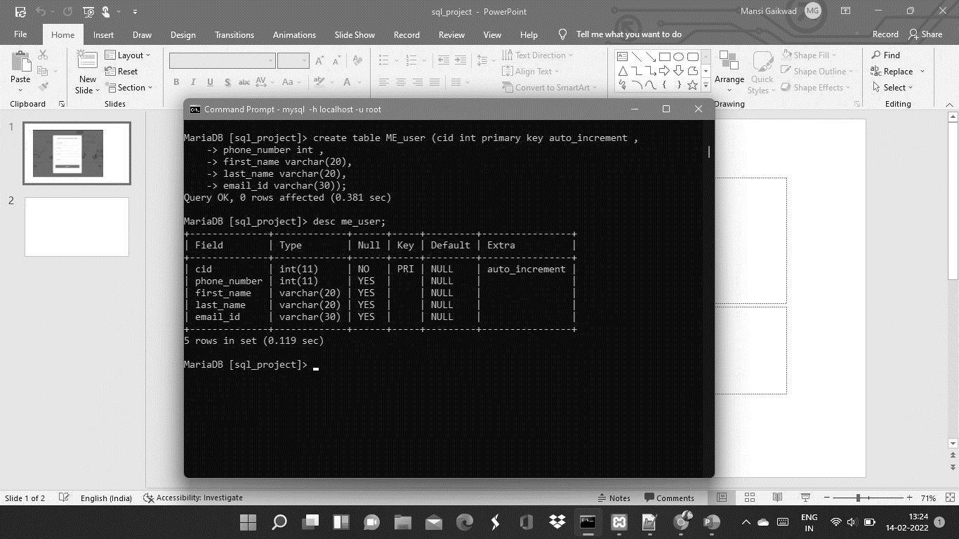
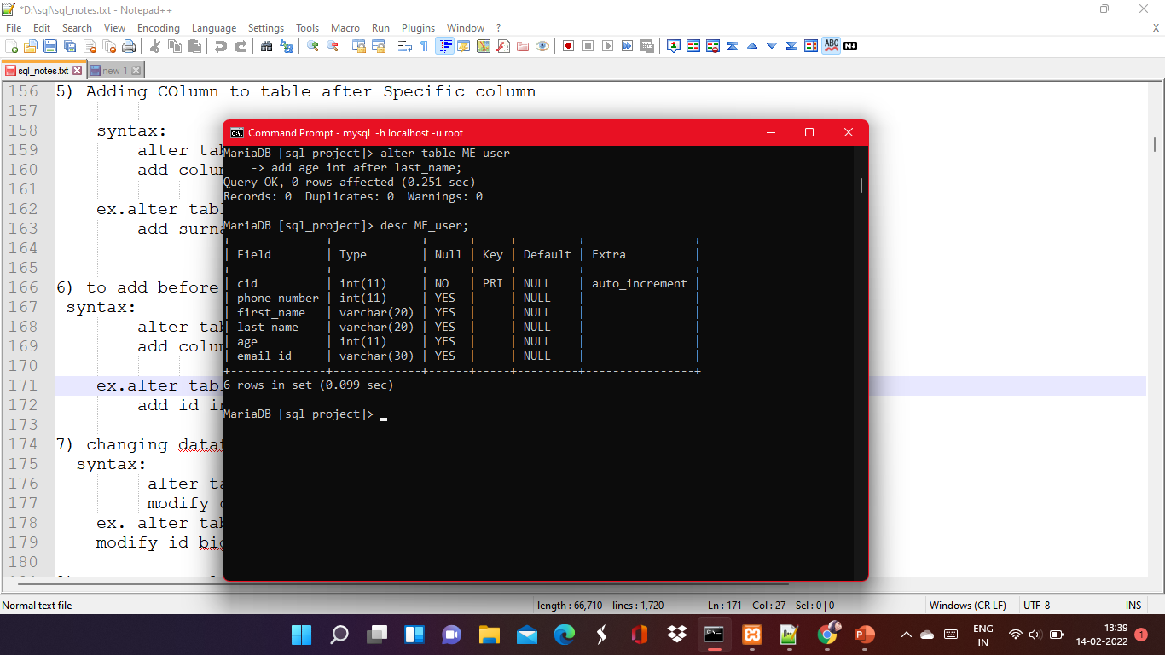
Using the DDL - Data Definition Language commands
Create – to create the table
2) Alter – To add a column

Slide 4
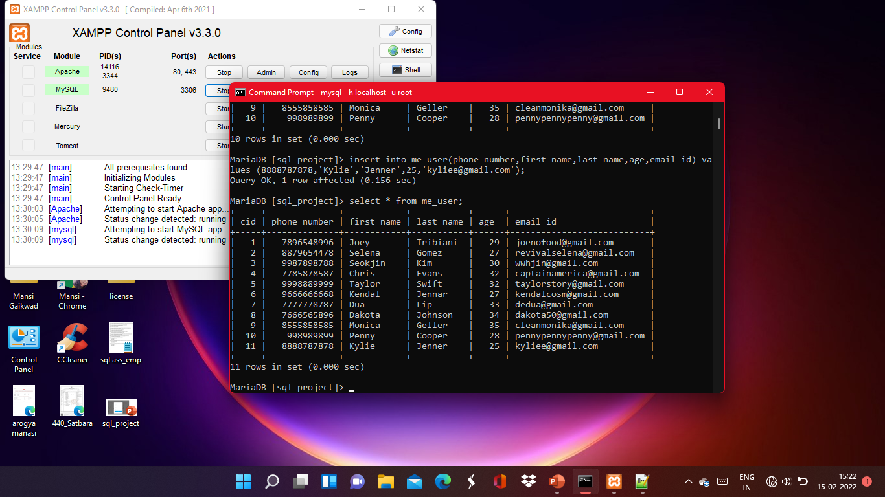

Slide 5
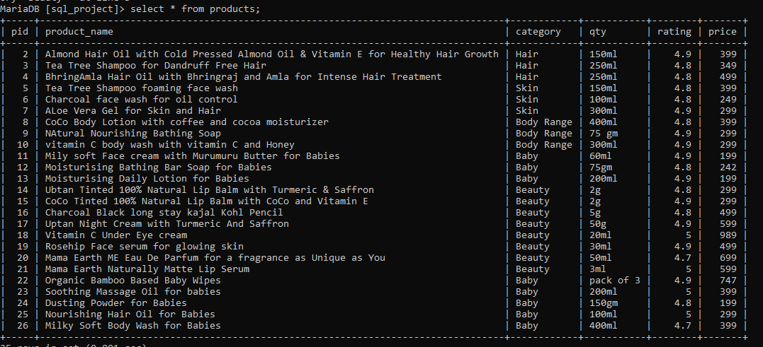
Home Page
Shows all the Products.

Slide 6
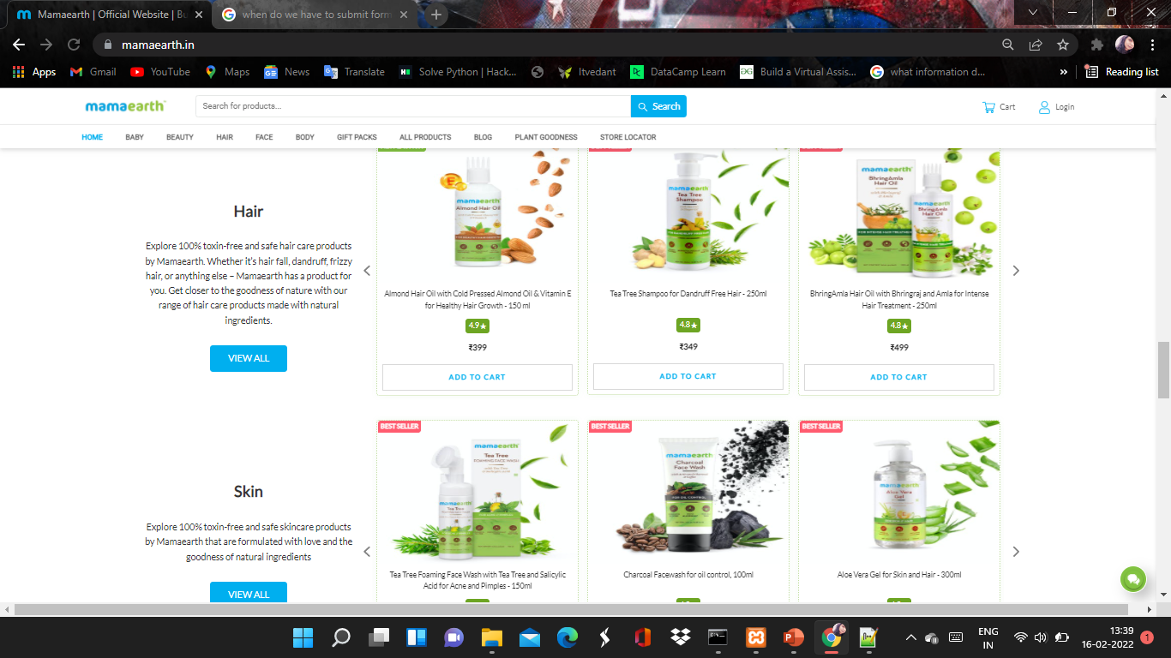
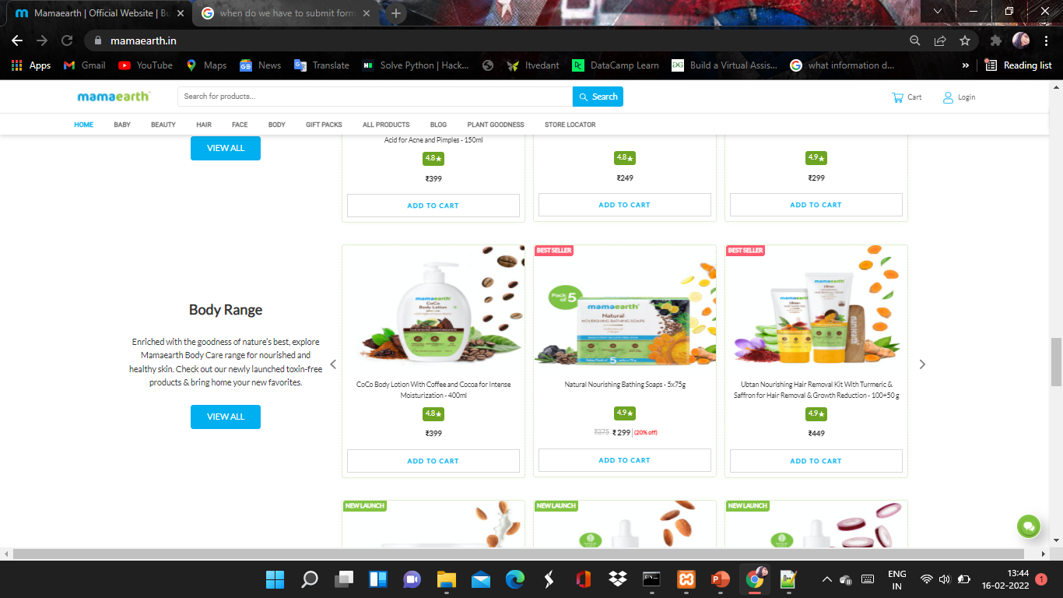

Slide 7
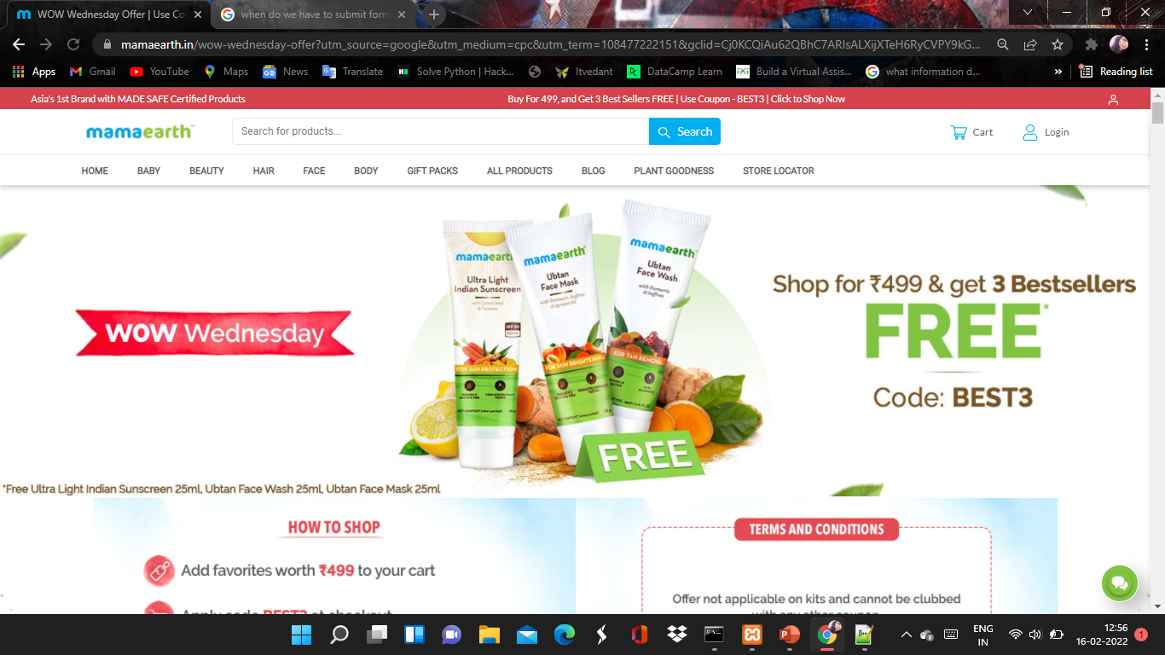
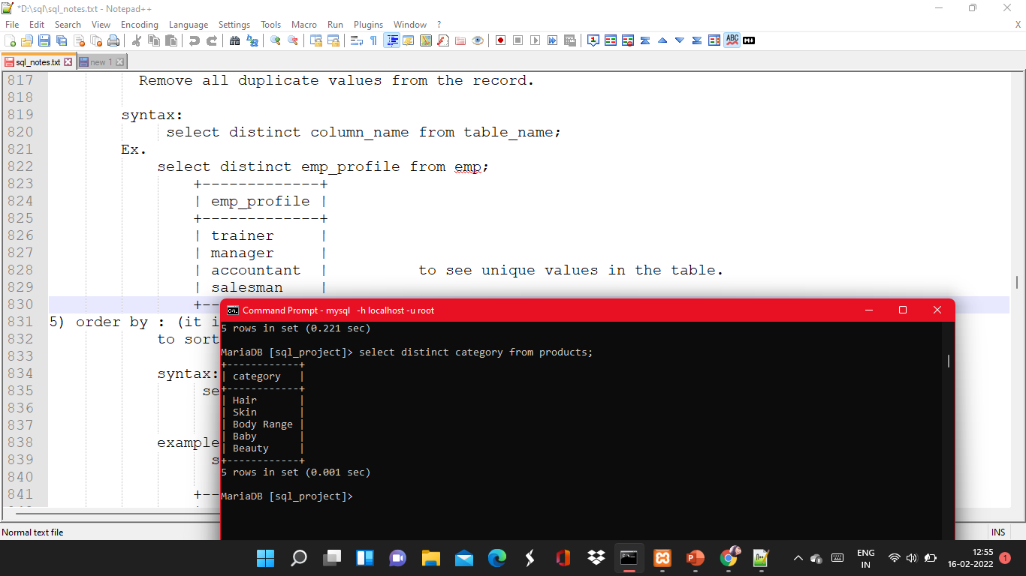


Distinctive
When the Customer wants to see the categories available on this site.

Slide 8
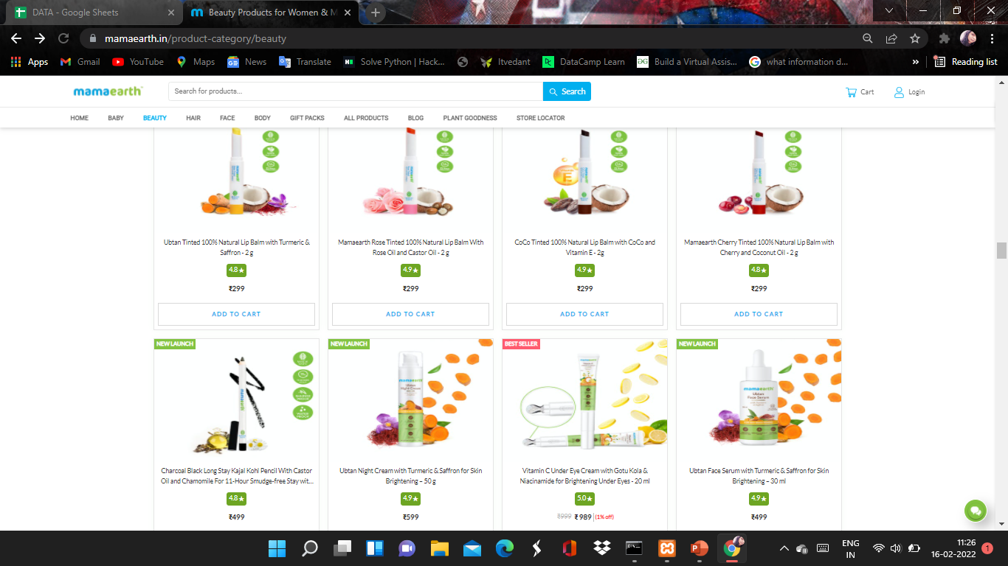
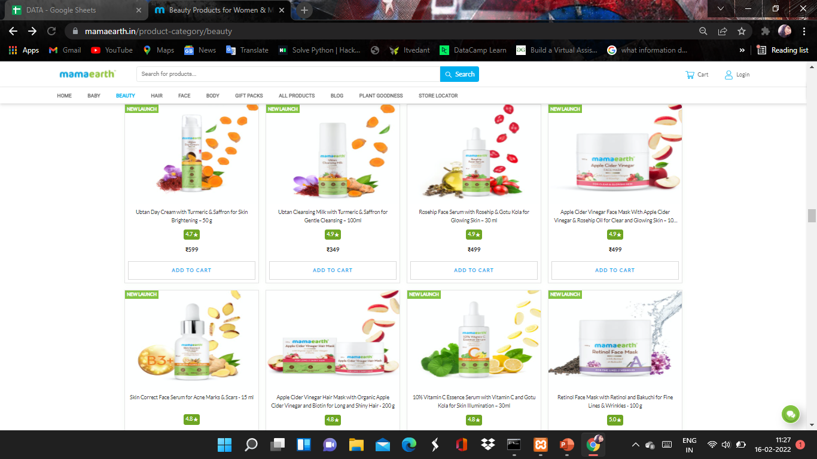
The Customer Wants to Shop for Beauty products .
Using WHERE Cluase to Show them the Product list with Beauty Products only.

Slide 9
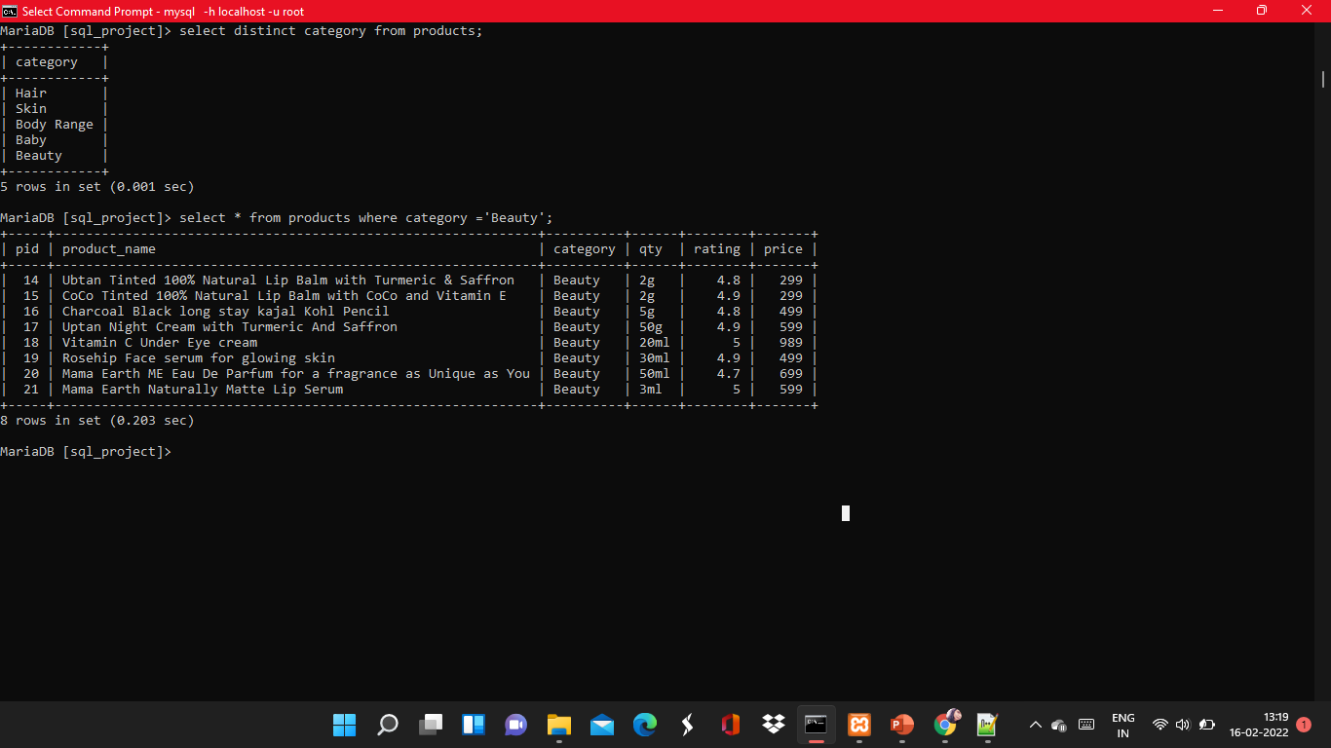

Slide 10
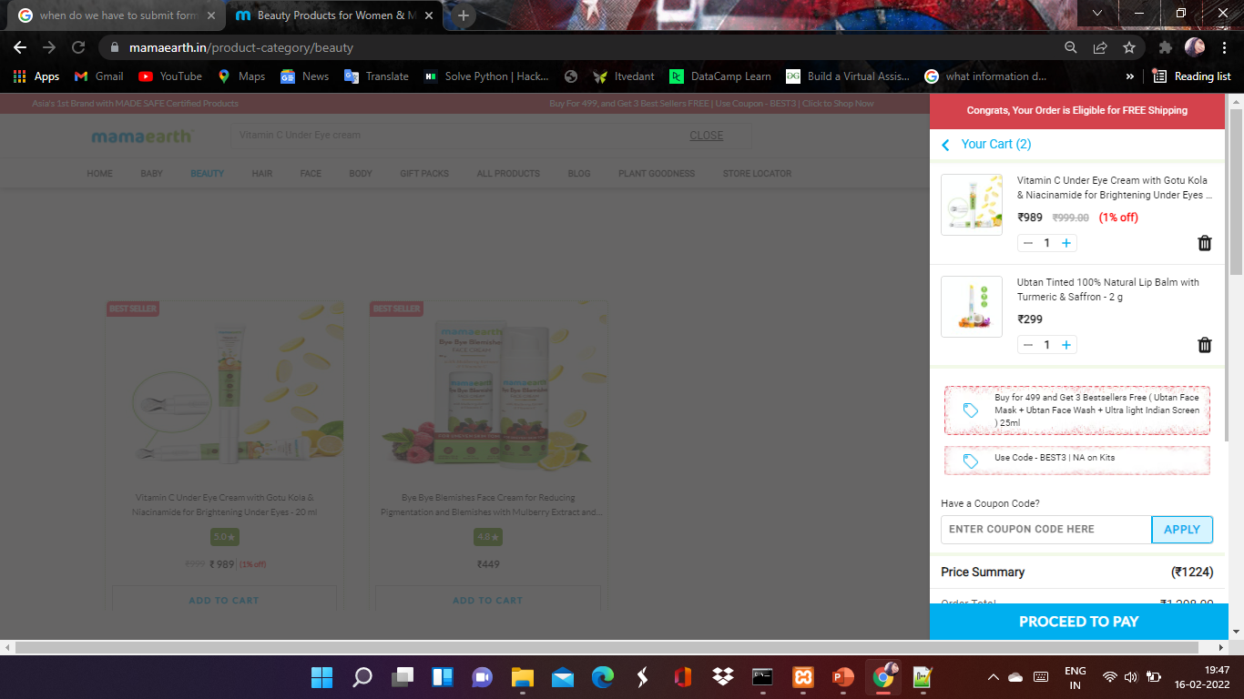
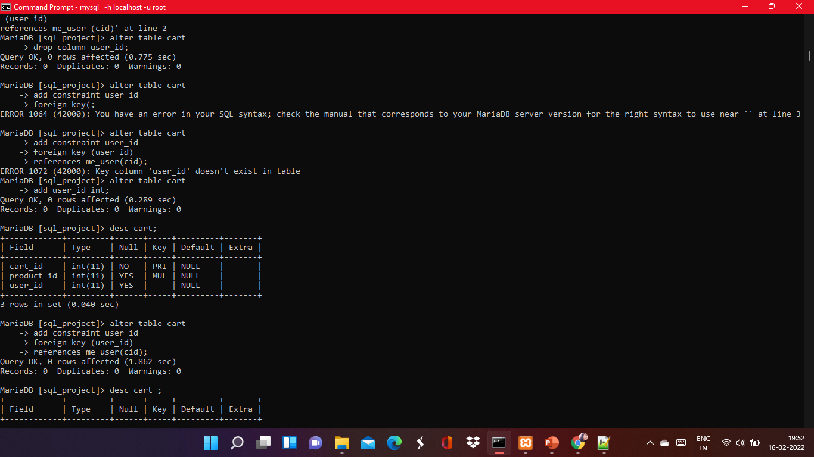
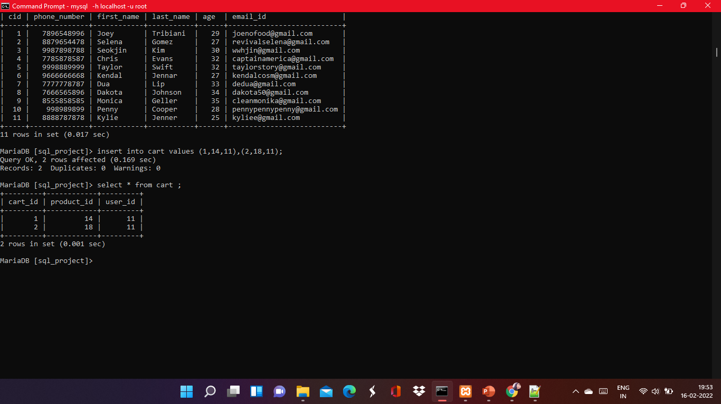
User Kylie with user id 11 wants adds beauty products to their cart .
Here’s how the cart table would look.

Slide 11
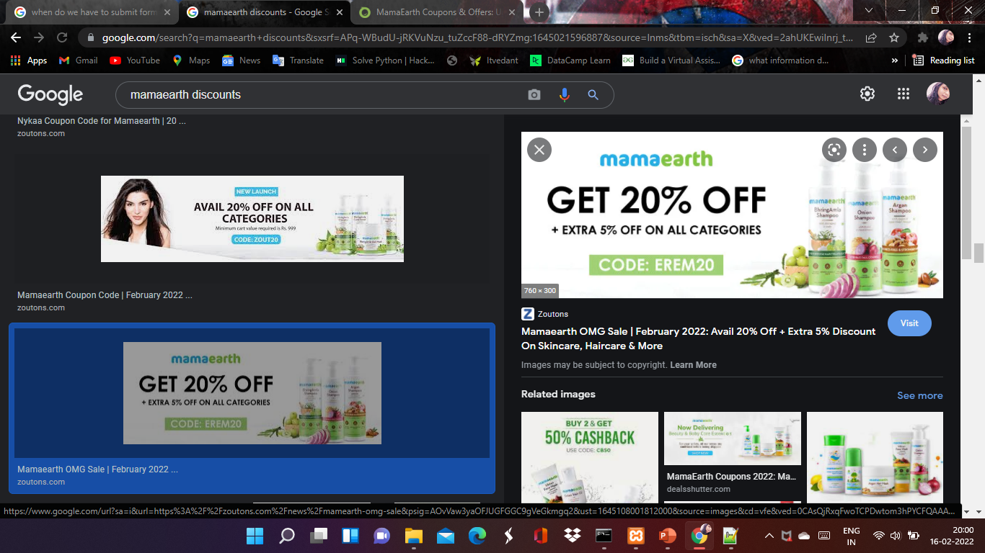
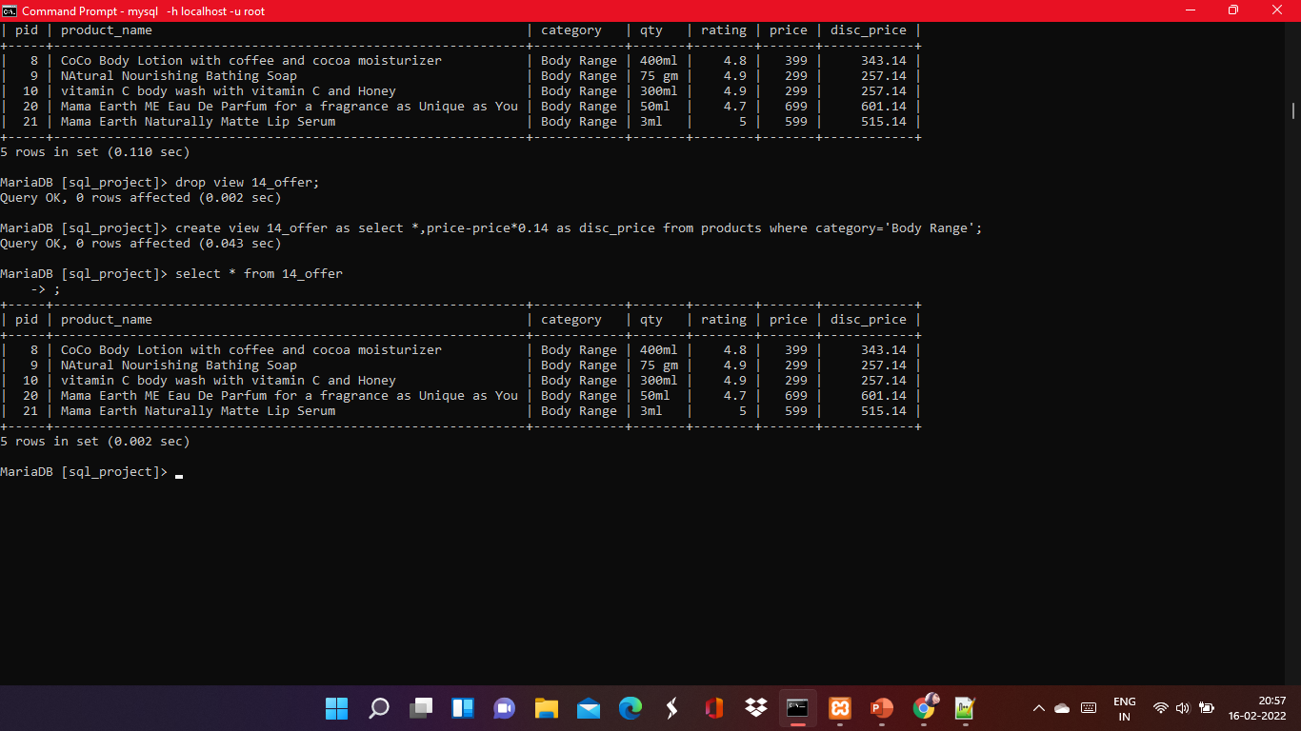

Valentine’s Day Offer !!!
14% off on Mama Earth’s Body Range
Creating a view for Valentines Day Offer .

Slide 12
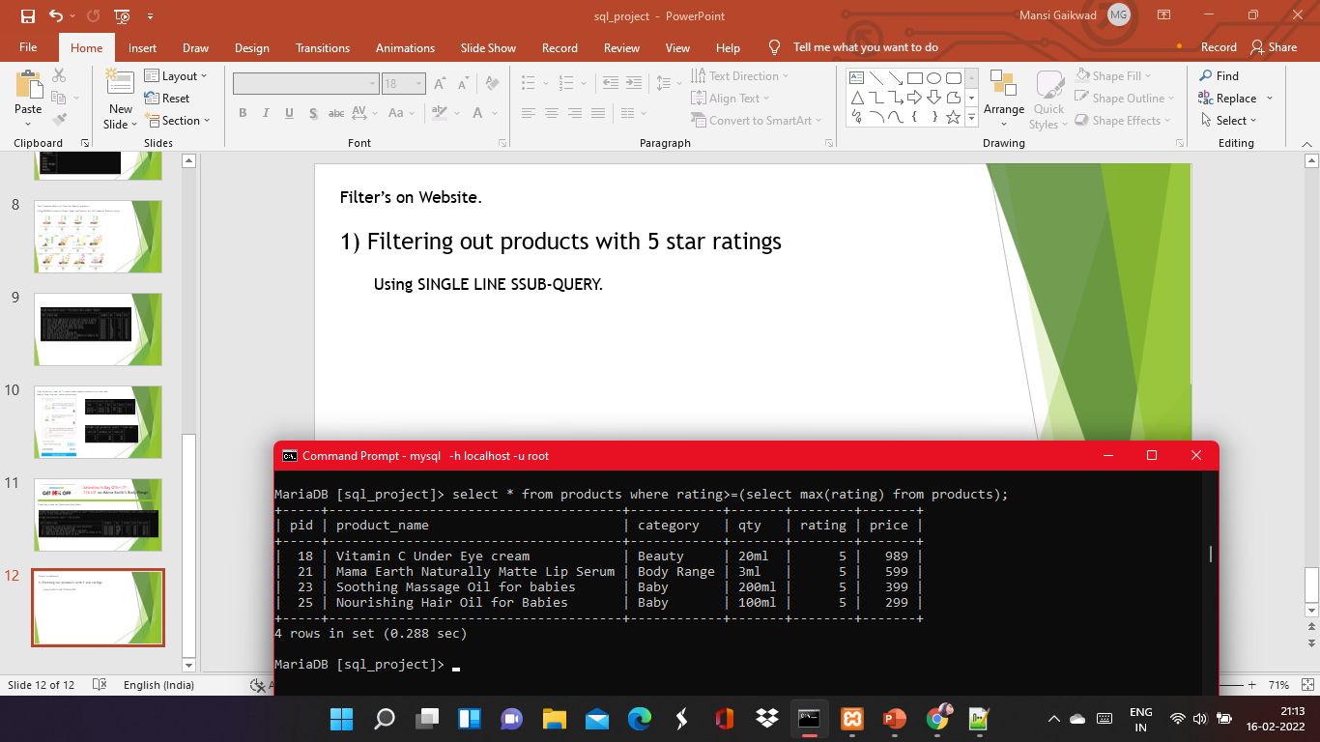
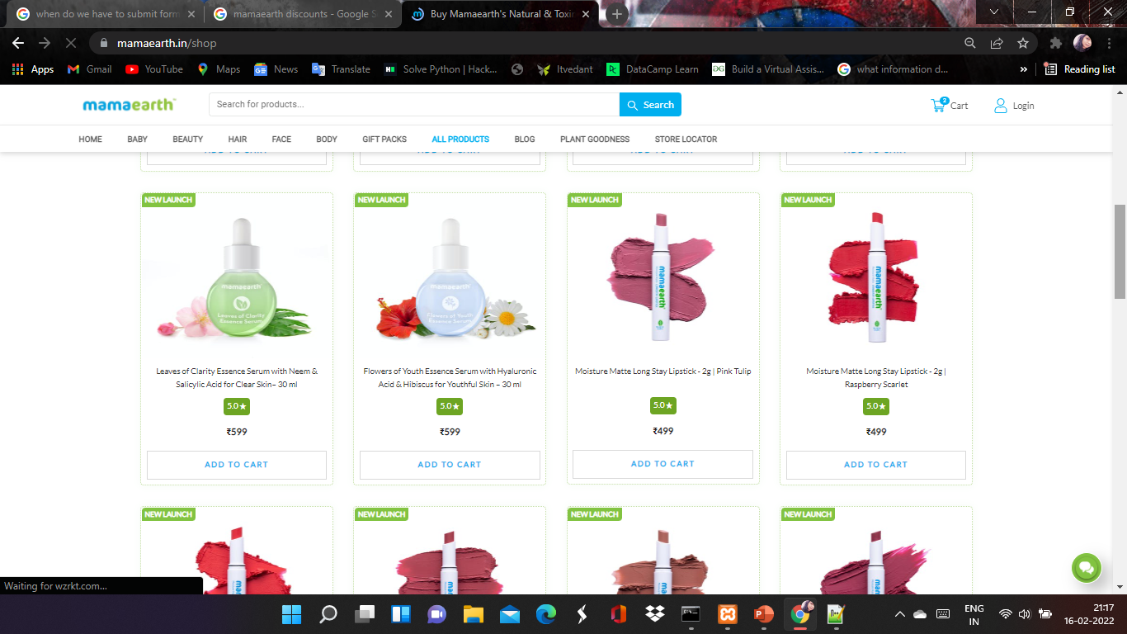
Filter’s on Website.
1) Filtering out products with 5 star ratings
Using SINGLE LINE SUB-QUERY.

Slide 13
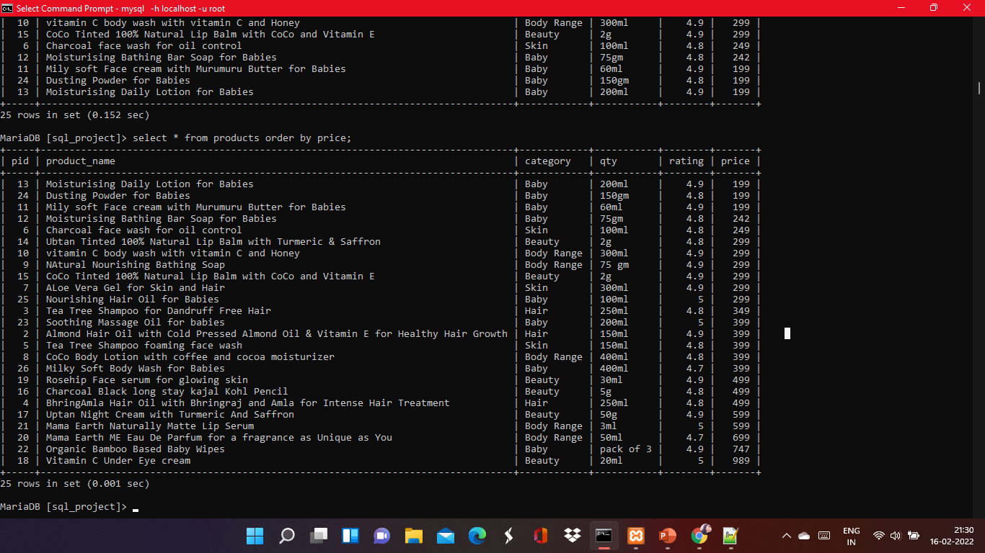
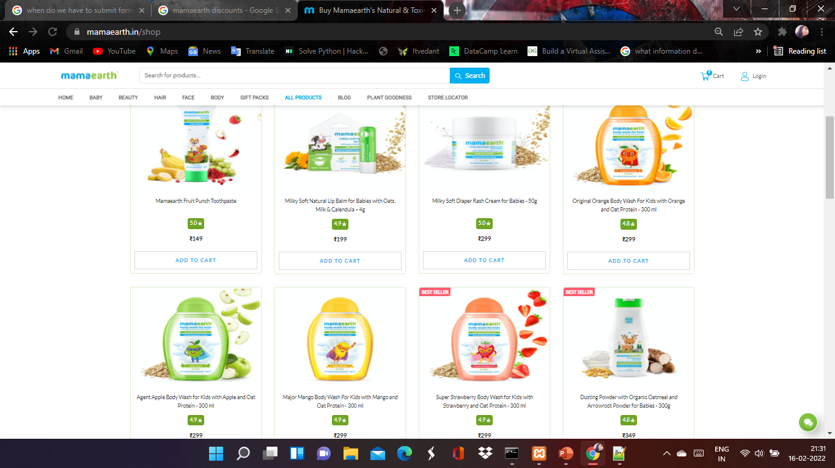
View all the products and sort by price low to high .
Using Order By .

Slide 14
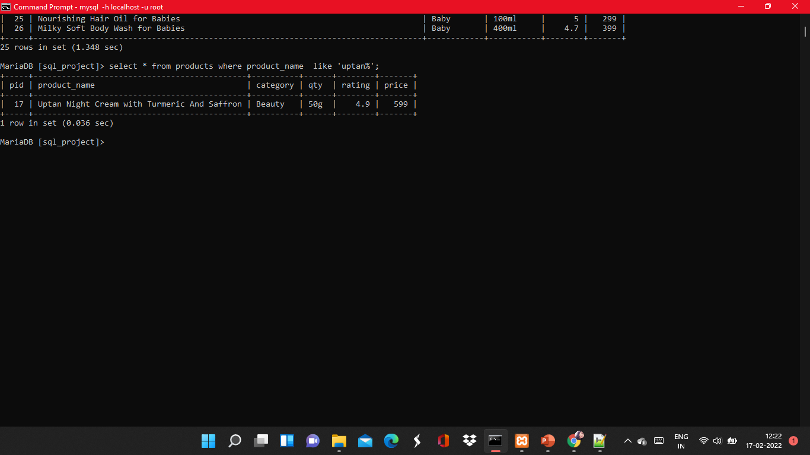
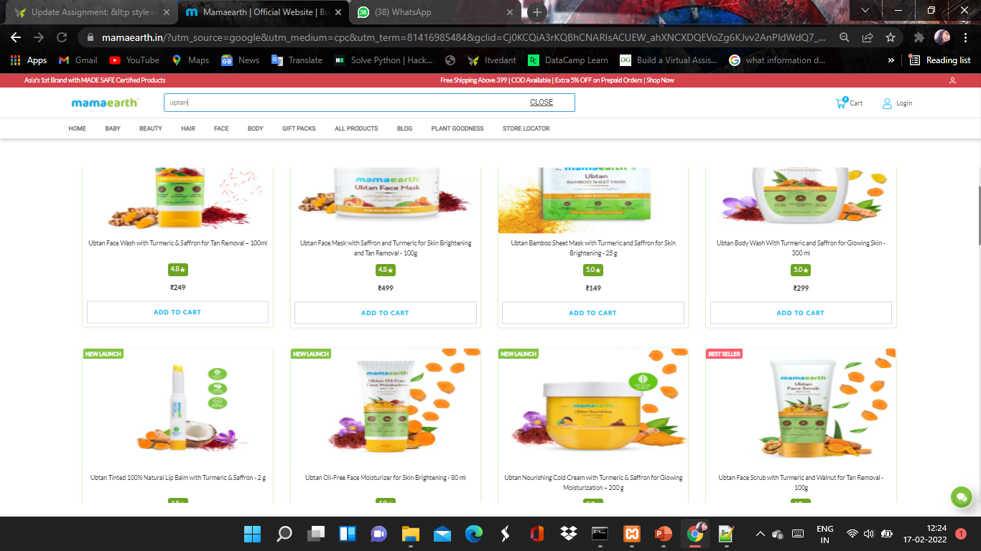
To see All the products from “UPTAN”
Using “LIKE OPERATOR”

Slide 15
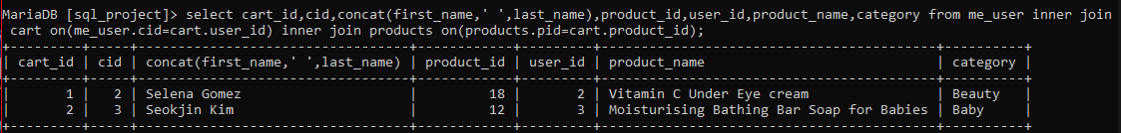
Inner Join
Cart Details (USER + PRODUCTS + CART)

Slide 16
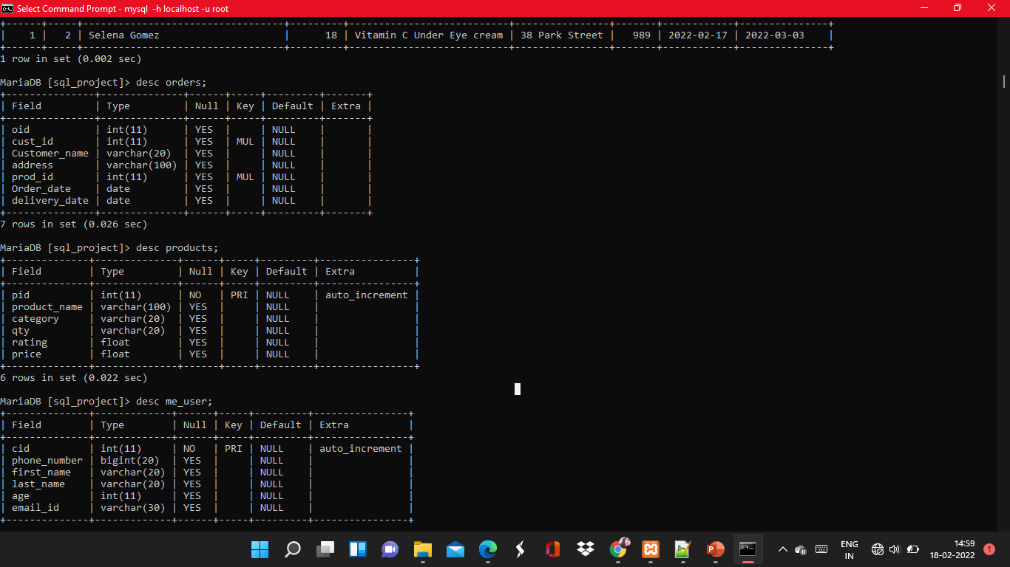
Using orders , products and users table to create the Invoice

Slide 17
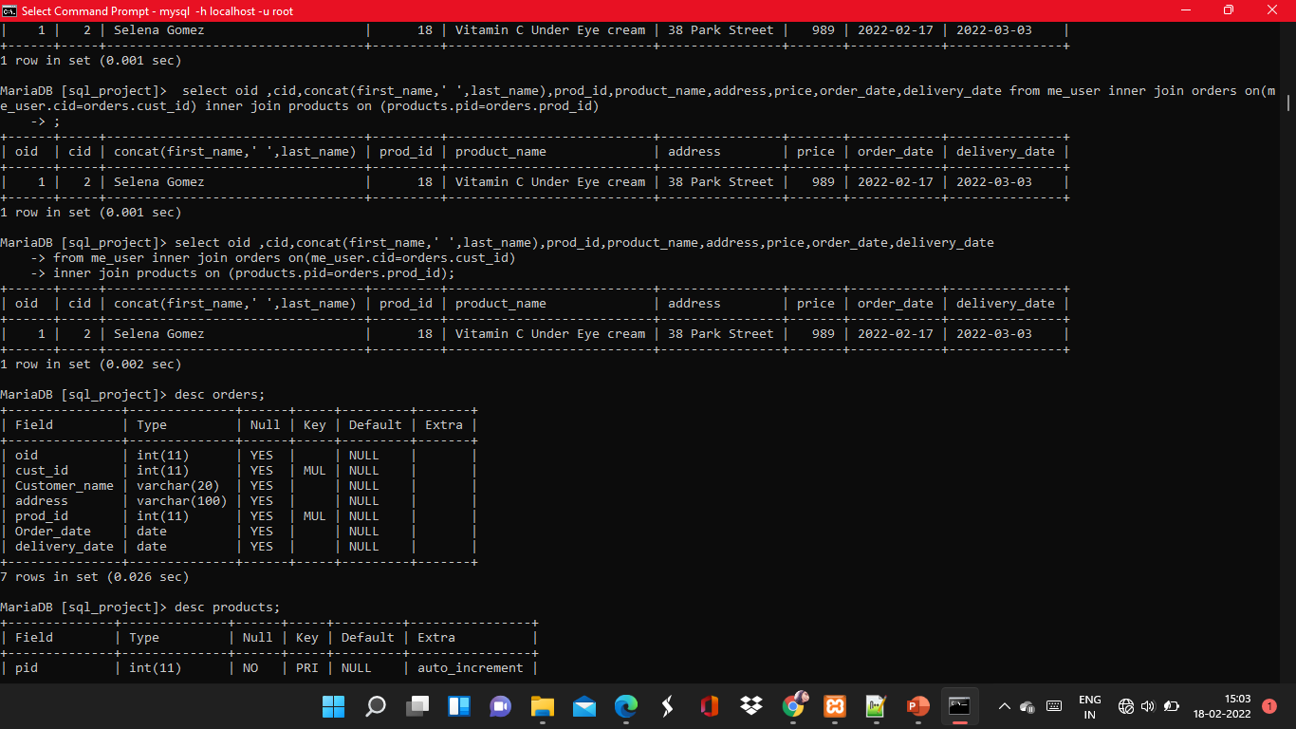
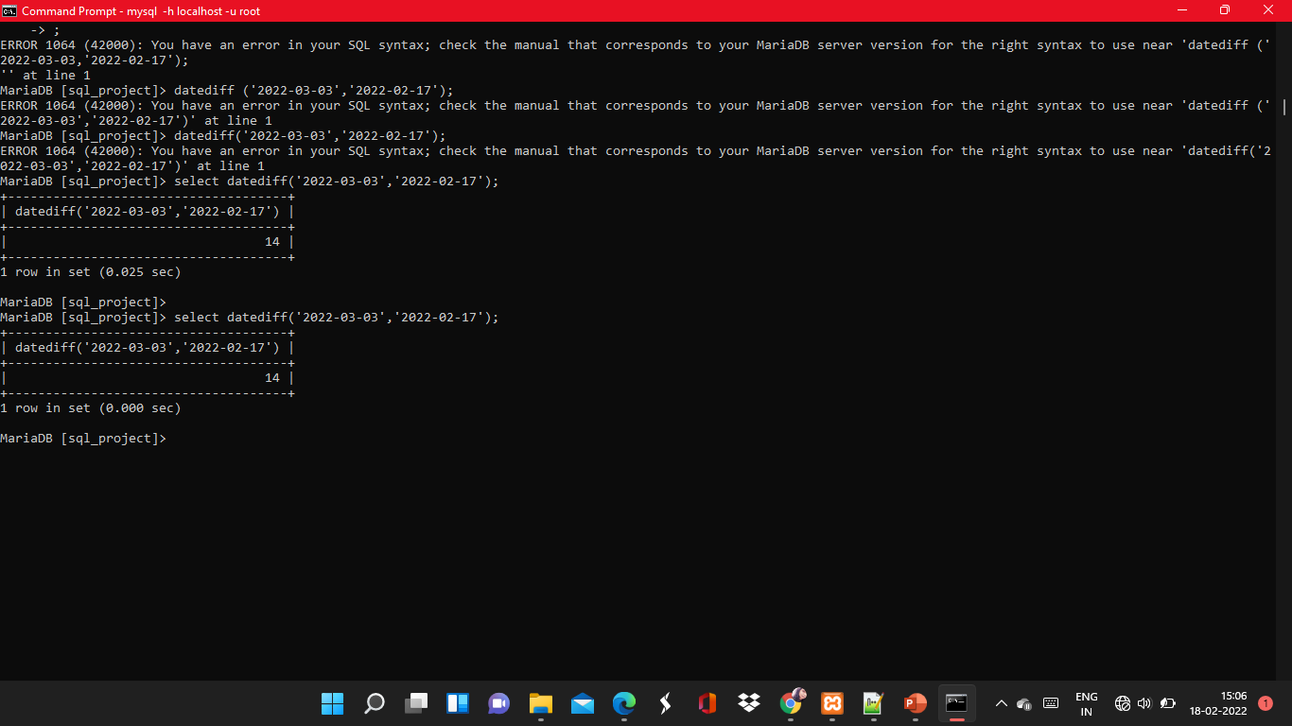
INVOICE
To track days left for package to arrive

Slide 18

Thank You!!!

